Slide 1

Final Thesis Presentation
Secured Internet of things (IoT) model using Blockchain Md. Abdullah Al Noman 16201041 Jabed Omar 16201067
MD. Borhan Uz Jamil 16201026 Fuad Hossain Oni 18241017 Abdul Muneem Khan 16101285
Supervisor: Dr. Muhammad Iqbal Hossain

Slide 2
Outline
Introduction
Motivation
Problem Statement
Research Objective
Proposed Model
Experimental Progress of the Model Result Analysis
Limitations and Future Works Conclusion

Slide 3
Introduction
Rapid Grow of a new technology
Every device is Connected with each other
Security and Privacy Issue
Motivation
Lack of Proper Security
Advancement of Hacking System

Slide 4
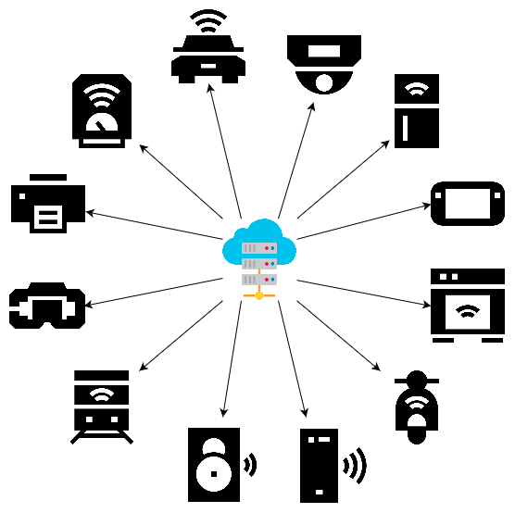
Problem Statement
Data is not Secured in Centralized Server
Need Advance Technology to Avoid Trespassing
Research Objective
Instead of Centralized Server system, To use Decentralized system
Build an IoT Model Using Blockchain

Slide 5
IoT (Internet of Things)
Bunch of Devices that are Connected to the Internet
Past, Present and Future Condition of IoT
Security Threats in IoT
Physical Layer | Interface, Jamming, Sybil, Eavesdropping
Network Layer | Routing Attack, DoS/DDoS, Network Injection, Man-in-the-Middle
Application Layer | Data Leakage, Malicious Code, Misconfiguration, Sniffing Attack

Slide 6
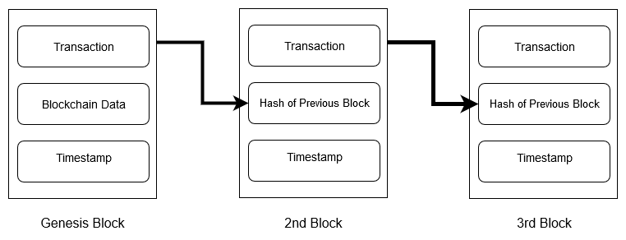
Blockchain
A decentralized ledger
A growing list of records,
called blocks, that are
linked using cryptography
Forms of Blockchain
Public Blockchain
Private Blockchain
Blockchain & Bitcoin is not same

Slide 7
Literature review
Existing work :
In [1], Showing a comparison that using blockchain provides far better services than not using blockchain
Our work :
Have studied that conventional system (centralized) is prone to threats here, So blockchain can be a better option

Slide 8
Literature review
Existing work :
In [2], authors designed a blockchain based system that permits user to run and control IOT devices arranged in group.
E.g. Smart city Light
Control System
Our work :
Proposed system is designed for individual devices

Slide 9
Literature review
Existing work :
In [3], System verifies face data from blockchain using a webcam
Verify webcam
Our work :
Ethereum address verification
Verify provided Ethereum address is enlisted or not

Slide 10
Literature review
Existing work :
In [4], System is not cost and energy efficient
Storage issue is not mentioned
Our work :
Cost and energy should not be an issue for our model right now. However if implementing on a large scale in future, those could be an issue
Storage will not be an issue as we are storing only an array of addresses in Blockchain

Slide 11
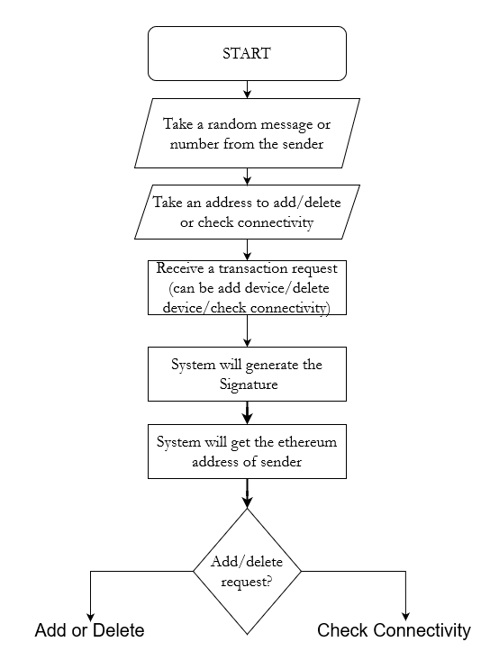
Proposed Model
Flow Chart

Slide 12
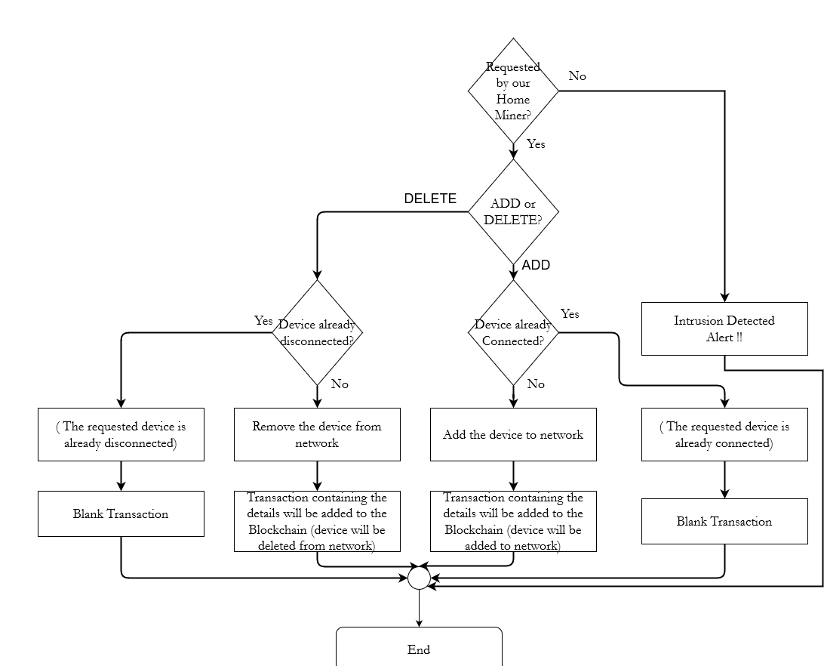
Proposed Model
Flow Chart → Add/Delete

Slide 13
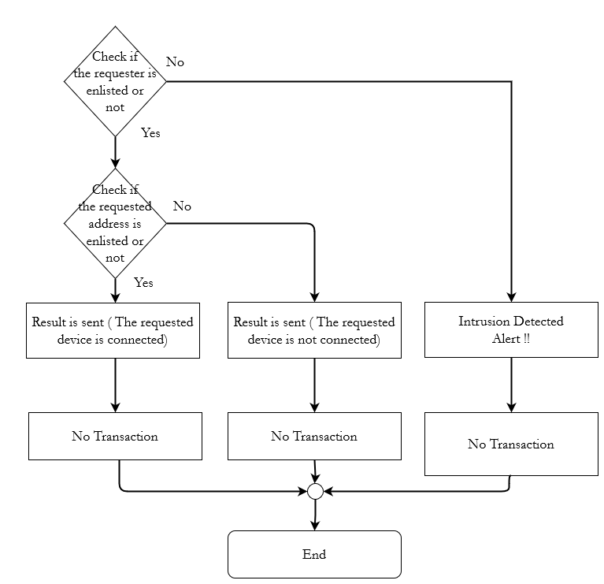
Proposed Model
Flow Chart → Check Connectivity

Slide 14
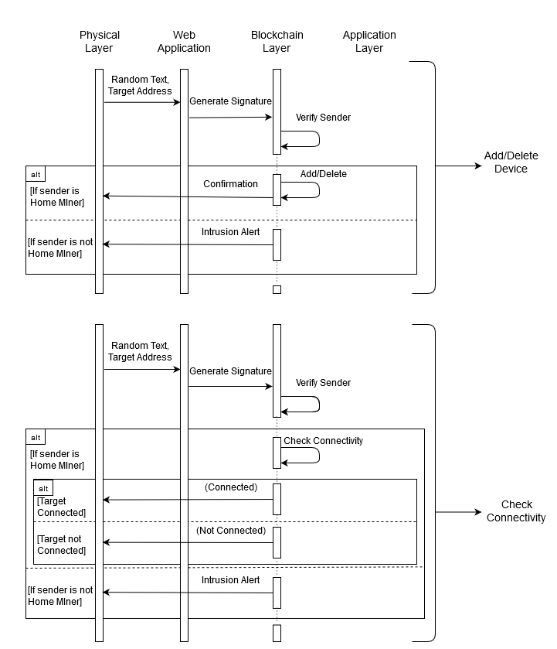
Proposed Model
Sequence Diagram

Slide 15
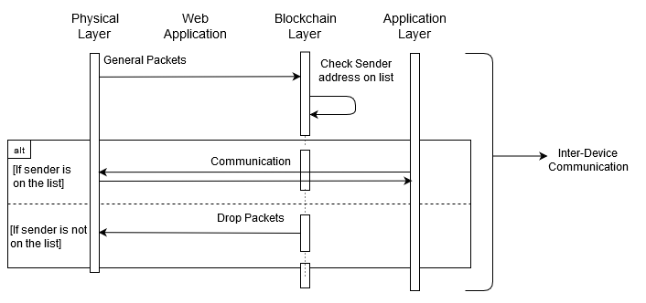
Proposed Model
Sequence Diagram

Slide 16
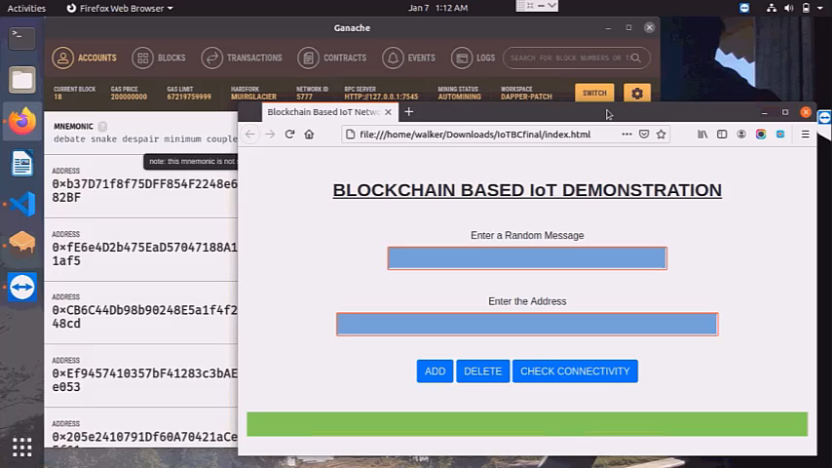
Experimental Progress

Slide 17
Result Analysis
Generating Transactions
‘Mempool’ as a waiting room
Size of a Blockchain
Difference in the Cost
Limitations and future works
Running Blockchain 24/7
Memory or Processing power
Manual rather than Automatic

Slide 18
Conclusion

Slide 19
THANK YOU !!!

